Slide 1

Biomedical Systems—I

Slide 2
Introduction
The long list of disciplines covered by soft computing includes the very exciting and prominent field of biomedical systems.
The use of soft computing in the medical domain might look very strange. If you ask a child the latest developments in this field, he might probably answer the discovery of new drugs, new surgical methods, etc.
Throughout the text we have talked about soft computing systems in terms of a design-oriented approach.
Unlike the other systems that we studied, this domain coves a very rich literature that has developed and grown extensively over the years.
This further necessitates a proper collaborative effort among the people who fully understand the biomedical systems (the doctors) and the people who understand the soft computing systems (the engineers).

Slide 3
Need and Issues
Today doctors and engineers work together on every problem in order to try to devise systems that are able to automatically detect diseases.
The need for such systems is more than just a gift of soft computing. The rapid increase in the number of disease cases has resulted in the need of systems that can detect diseases to relieve doctors and very quickly analyze the possibilities of various diseases.
Although soft computing measures have achieved great heights and have been able to solve numerous problems with very high efficiencies, yet the results are not 100 percent correct.
But these systems do aid the doctor to make fast decisions and help in making timely, effective decisions.

Slide 4
A Machine Learning Perspective
We have emphasized the importance of learning from the past data numerous time. This learning helped the systems to give correct output whenever that the same comes again.
This chapter does not focus solely on the study of biomedical systems and diseases. We rather aim to understand soft computing techniques in relation to machine learning.
We adopt a multidimensional approach here in which numerous diseases are approached in numerous ways.
The inferences and results give us valuable data to gain a deep understanding of the ways in which the various techniques work for machine learning.
Finally, we use these inferences to validate or contradict the views we have presented on the working of these systems.

Slide 5
Diseases
The general term disease means disease or not being at ease. It refers to the well being and comfort of the person.
The diseases greatly vary in their impact and cure. Some diseases like headache, fever, etc., are very minor conditions that many of us face in daily lives.
It is natural that one would not use any biomedical system for the purpose of detecting fever. A thermometer would definitely solve the purpose better.
It may be seen here that medical technology has made fabulous contributions in the past few decades.
In this chapter we present various approaches of classification, including ANN with BPA, RBFN, and LVQ.

Slide 6
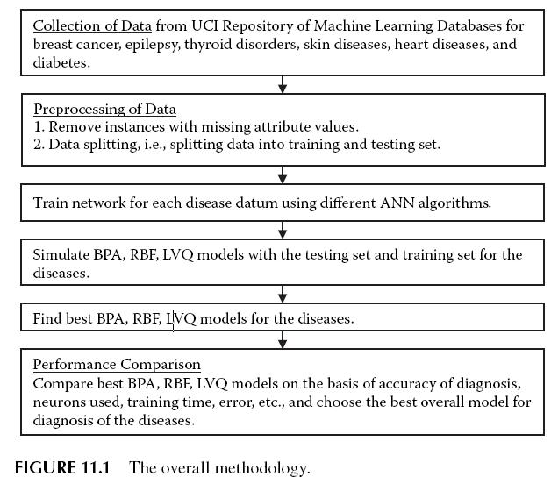
Diseases

Slide 7
Methodology
In this chapter we adopt an engineer’s approach to solving the problem of disease identification. Here we do not go deep into the details of biology, medical systems, and diseases.
Here we mainly discuss six different diseases and develop systems for them. We first consider breast cancer and then in turn epilepsy, thyroid disorders, skin diseases, heart diseases, and diabetes.
ANN CLASSIFIERS
Here we have used three ANNs for the purpose of classification: the back propagation algorithm (BPA), radial basis function network (RNFN), and learning vector quantization (LVQ).
Hence the entire discussion revolves around classification.

Slide 8
ANN CLASSIFIERS
Why not store each and every datum into some storage and later use this storage primarily as a lookup table? Here there is one major issue.
The solution to this problem that may again arise in the minds of the readers is that by various ways the lookup table can be modified to incorporate this ability to withstand deviations up to a predefined level.
Now we discuss another problem using this approach. In any real-life application, the number of cases may be too large.
This necessitates systems that may store the large volumes of data and also provide scope for errors or noise.
Here we would study three distinct ways to do this task of formation of rules or representation of the training data by a set of rules. These are discussed in next three subsections.

Slide 9
ANN with BPA
The ANN with BPA is one of the most common methods that we have been using throughout this text.
In case of the classificatory problems, the ANNs try to frame functions that have maxima around the regions that denote the presence of the disease and minima at the regions that denote the absence of the disease.
This means that the ANN must correctly identify the maximum possible training set inputs in the least amount of space. This further reduces the testing time requirements as well.
In short, the BPA approach says, as far as possible, form the global rules after considering all the training inputs and tries to form a function that covers the entire region that includes the input space where the class is present.

Slide 10
Radial Basis Function Networks
The RBFNs have quite a different manner of working and solving the same problem of learning. We discussed the mechanism in detail in previous chapters.
Here we talk about the same issues and solutions with respect to the issues of machine learning that we introduced.
This function may even be replaced by a function whose value is above a threshold at regions where the class is found and below the threshold where the class is not found.
It must be noted that even the ANN with BPA actually is unable to imitate the binary function due to its characteristic nature where the outputs do not change at all over any change in inputs but then suddenly change.

Slide 11
Learning Vector Quantization
The LVQs also represent a localized approach to problem solving by the use of ANNs. Given how they operate, LVQs may be considered even more localized than RBFNs.
This is chiefly because these are by design classificatory models that try to return a single class as their output.
For all these ANNs, we comment in general that they would be able to learn almost any training input data if we keep increasing the number of neurons.
Hence the resulting system will be more or less a lookup table with a highly localized extent.
A time will come when it will have enough freedom to change and assume very complex shapes and hence classify the problem.

Slide 12
Data Sets
Recall that any recognition system has the tasks of data acquisition, preprocessing, segmentation, feature extraction, and then recognition.
It may be noted that the data collected in this database are not normalized and vary widely in range.
The engineers very frequently use the UCI Repository as a black box where they apply the methods of machine learning without considering the systems and attributes.
Here we face the same problems. Explaining the symptoms, causes, results, and dependencies of the various diseases would take volumes of text.
We collect some valuable data from these systems and then continue our discussion in order to fully understand the working of the machine learning systems.

Slide 13
BREAST CANCER
The first disease that we consider in this system is breast cancer.
Cancer is a group of diseases in which cells are aggressive (grow and divide without respect to normal limits), invasive (invade and destroy adjacent tissues), and sometimes metastatic (spread to other locations in the body).
Worldwide, breast cancer is the fifth most common cause of cancer death (after lung cancer, stomach cancer, liver cancer, and colon cancer).
The mainstay of breast cancer treatment is surgery when the tumor is localized, with possible adjuvant hormonal therapy (with tamoxifen or an aromatase inhibitor), chemotherapy, and/or radiotherapy.

Slide 14

Data Set of Breast Cancer
The data set consists of 699 instances. Out of these, values of one or more attributes are missing in 16 instances.
There are 9 attributes per instance plus the class attribute. Each of the instances has to be categorized into either of the two categories: benign or malignant.
The class distribution is: Benign: 444 (65 percent) Malignant: 239 (35 percent). Attributes of the data set are: (1) Clump Thickness; (2) Uniformity of Cell Size; (3) Uniformity of Cell Shape; (4) Marginal Adhesion; (5) Single Epithelial Cell Size; (6) Bare Nuclei; (7) Bland Chromatin; (8) Normal Nucleoli; (9) Mitoses.

Slide 15
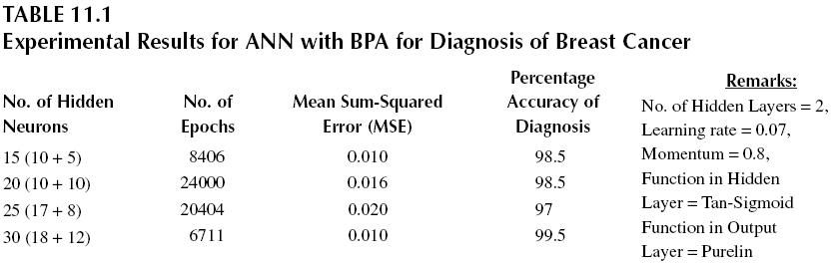
Results
ANN with BPA
The database as obtained for the problem was first trained by the use of ANN with BPA. The ANN consisted of two hidden layers.

Slide 16
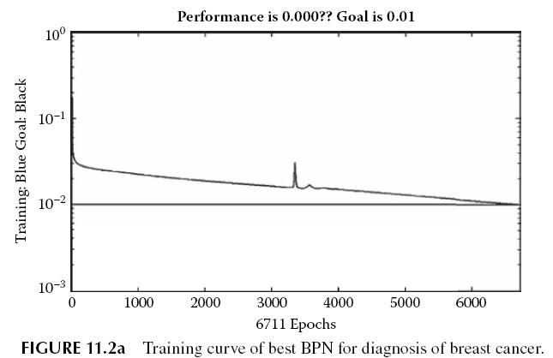
ANN with BPA
Figure 11.2a shows the training curve for the best ANN with BPA for the diagnosis of breast cancer, and Figure 11.2b shows the graphical representation of accuracy of the best ANN for diagnosis of breast cancer. This shows that the diagnosis is correct in 199 out of 200 cases in this case.

Slide 17
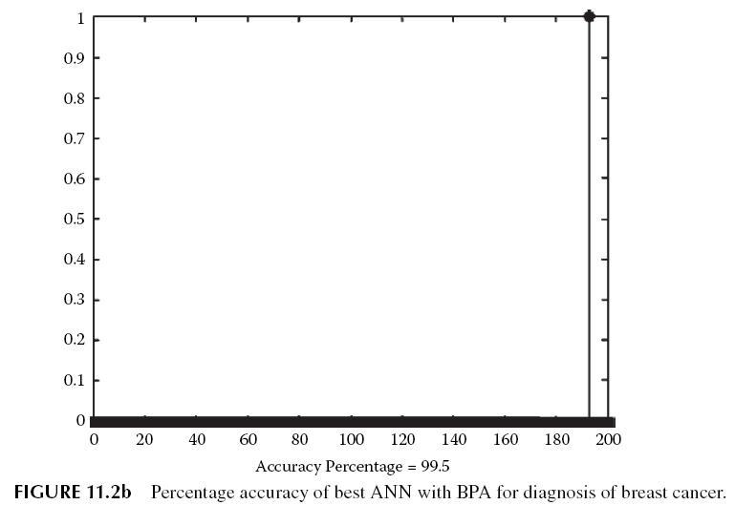
RBFN
In Radial Basis Function Networks, we need to specify the input values, target values, error goal, and spread value.

Slide 18
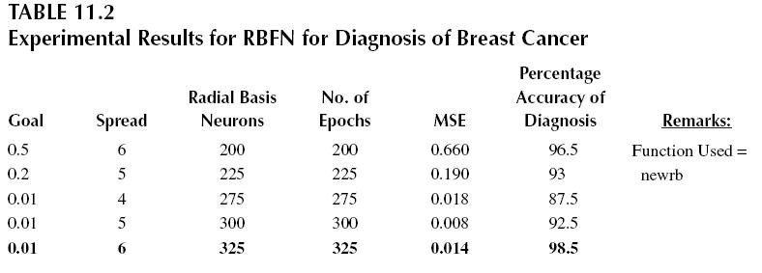
RBFN
The experimental results of diagnosis using RBF networks are shown in Table 11.2.
Figure 11.3a shows the training curve for the best RBF network for the diagnosis of breast cancer and Figure 11.3b shows the graphical representation of accuracy of the best RBF network for diagnosis of breast cancer.
This shows that the diagnosis is correct in 197 out of 200 cases in this case.

Slide 19
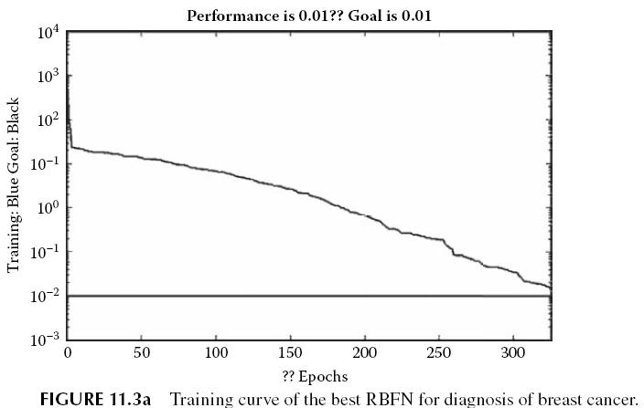
LVQ Network
In our experiment, different LVQ models were obtained by changing the number of hidden neurons. The Kohonen’s learning rate was set to 0.05.
Figure 11.4a shows the training curve for the best LVQ network for the diagnosis of breast cancer.

Slide 20
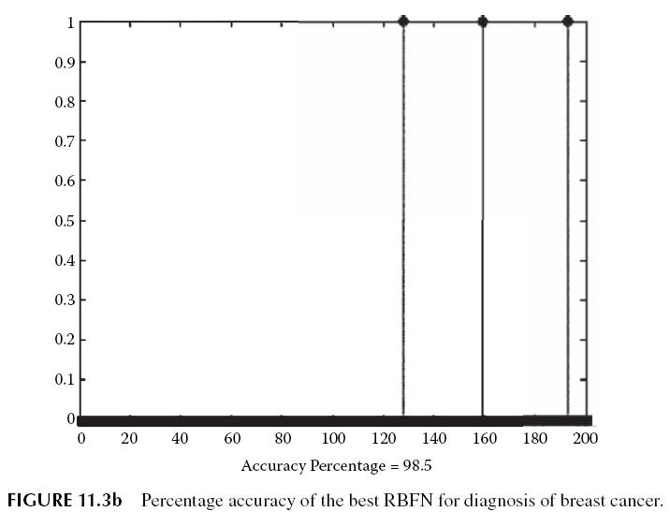
LVQ Network

Slide 21
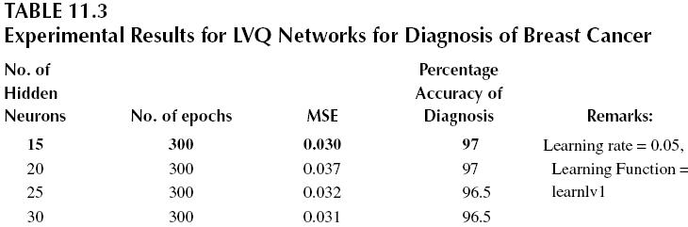
Performance Comparison
Table 11.4 shows the performance comparison of ANN models to find the best diagnostic system for breast cancer.
RBFN produces the second best accuracy on testing data set. RBFN takes the least training time out of the three networks, which is 38.75 seconds.
The LVQ network was less accurate than ANN with BPA and RBFN and took the largest time for training.

Slide 22
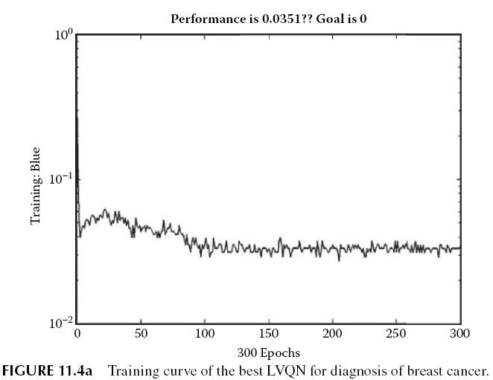
Performance Comparison

Slide 23
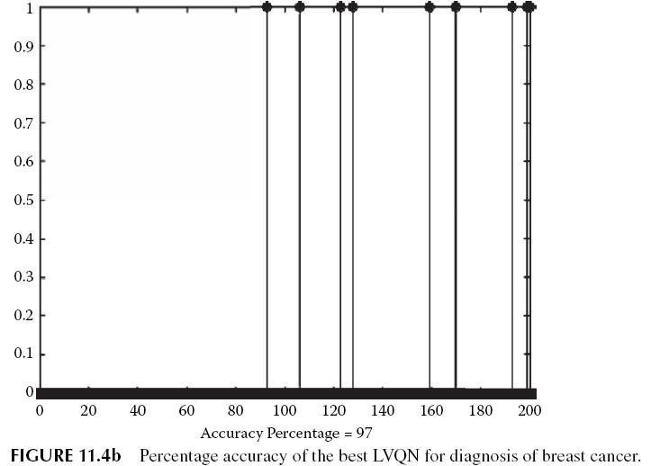
Performance Comparison

Slide 24
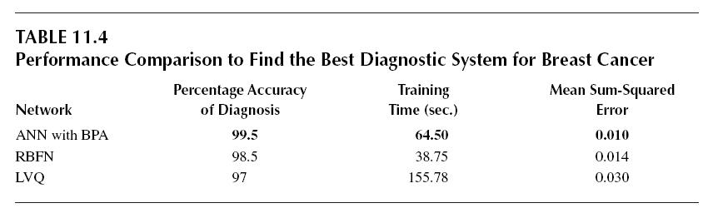
Performance Comparison

Slide 25
EPILEPSY
The second problem that we take to build a soft computing system is epilepsy. Epilepsy is a common chronic neurological disorder that is characterized by recurrent unprovoked seizures.
Information about existing resources available within countries to tackle the huge medical, social, and economic burden caused b epilepsy is lacking.
Epilepsy has serious social and economic consequences, too. People with epilepsy continually face social stigma and exclusion.
In 1990, WHO identified that, on average, the cost of the anti-epileptic drug phenobarbitone could be as low as US$ 5 per person per annum (WHO 2009).

Slide 26
Data Set for Epilepsy
The nine input values are derived from a 1/4-second “SPIKE” event that is recorded on a single channel of an EEG monitor.
A team of neurologists were asked to classify each spike as an epileptic event (True or False). The file contains 100 TRUE values and 165 FALSE values; total 265 patterns each having nine attributes.
First, all the data has been normalized so that the value of every attribute is between 0 and 1.
Out of 265 instances, 200 instances have been used for training the system and 65 have been used for testing purposes.

Slide 27
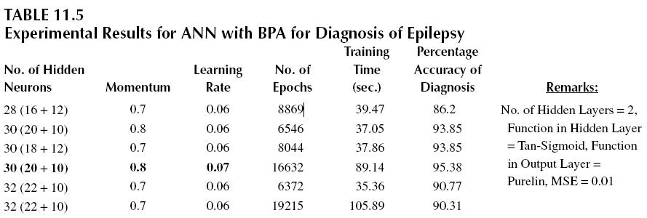
Results
ANN with BPA
After the ANN with BPA was created, just as in the case of breast cancer, the values of momentum, learning rate, and number of hidden neurons were changed to get different BPA models and choose the best one.
Table 11.5 shows the experimental results of diagnosis using ANN with BPA.

Slide 28
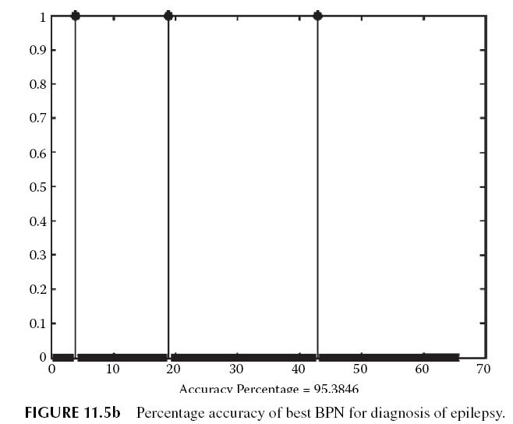
ANN with BPA

Slide 29
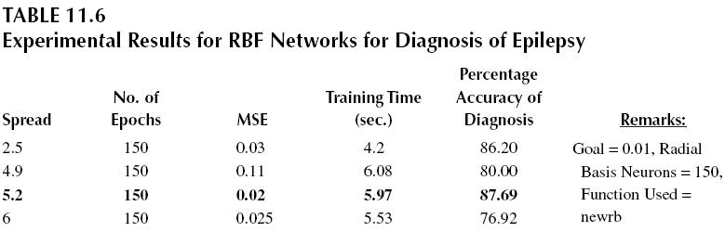
ANN with BPA
Figure 11.5b shows the graphical representation of accuracy of the best ANN network for diagnosis of epilepsy. This shows that the diagnosis is correct in 67 out of 70 cases in this case of epilepsy.

Slide 30
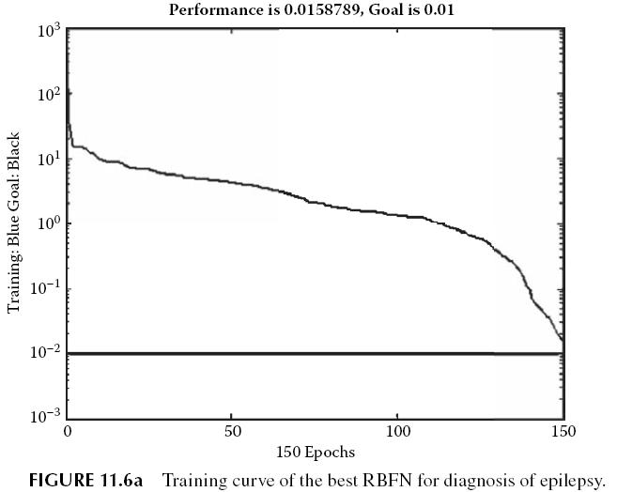
RBFN
After creating the Radial Basis Function Networks, just as in the preceding disease, the value of spread was changed to get different models.
Figure 11.6a shows the training curve for the best RBFN for the diagnosis of epilepsy and Figure 11.6b shows the graphica representation of accuracy of the best RBFN for diagnosis of epilepsy.

Slide 31
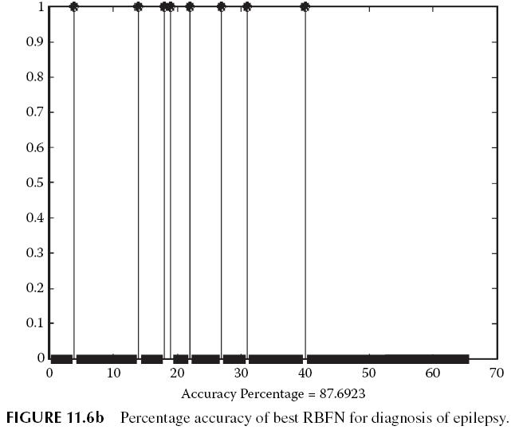
RBFN

Slide 32
LVQ Network
The Kohonen’s learning rate was set to 0.06, and the performance function used was MSE. Table 11.7 shows the experimental results for LVQ networks, which differ from each other on the basis of number of hidden neurons used.
Figure 11.7a shows the training curve for the best LVQ network for the diagnosis of epilepsy, and Figure 11.7b shows the graphical representation of accuracy of the best LVQ network for diagnosis of epilepsy.
This shows that the diagnosis is correct in 67 out of 70 instances in case of epilepsy.

Slide 33
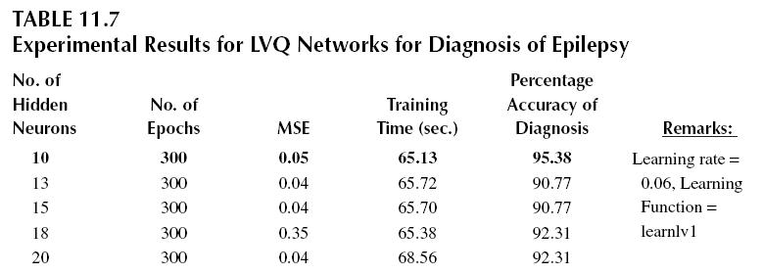
Performance comparison
Table 11.8 shows the performance comparison of the three ANNs to find the best diagnostic system for epilepsy.
For the diagnosis of epilepsy using the networks trained with the specified data, BPA and LVQ produce the same accuracy of diagnosis, but LVQ takes much less time in training than BPA to produce the same results. Hence, LVQ is better in this case.

Slide 34
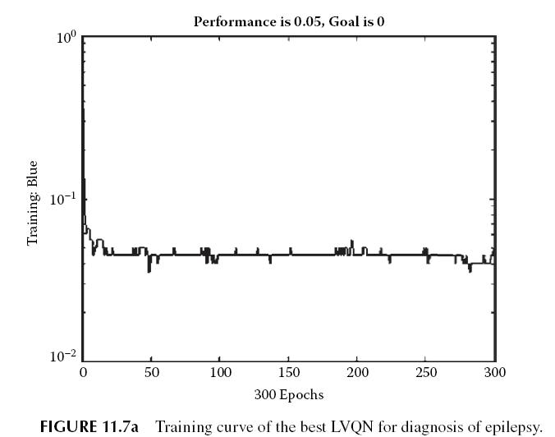
Performance comparison

Slide 35
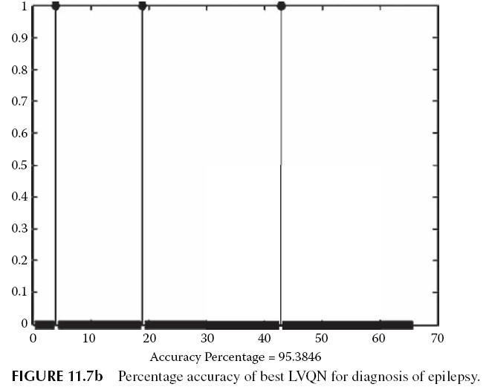
Performance comparison

Slide 36
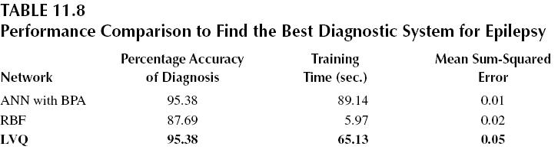
Performance comparison

Slide 37
THYROID
The third disease under study is thyroid. The thyroid is one of the largest endocrine glands in the body.
Prevalence of thyroid disorders is more than 23 percent and undiagnosed prevalence rate is approximately 1 in 20 (Nussey 2001, Wikipedia, “Thyroid”).
Researchers studied the relationship between thyroid disorders and glaucoma using a nationally representative sample of 12,376 adults in the U.S. who participated in the 2002 National Health Interview Survey.
Thyroid disorders could boost the risk of developing the eye disease glaucoma, according to research out today (Reinberg 2008).

Slide 38
Data Set for Thyroid Disorders
From the thyroid gland data set, 187 instances have been used for this work. Each instance has five attributes plus the class attribute.
The five attributes are: (1) T3-resin uptake test (a percentage) (2) Total serum thyroxin as measured by the isotopic displacement method; (3) Total serum triiodothyronine as measured by radioimmuno assay; (4) Basal thyroid-stimulating hormone (TSH) measured by radioimmuno assay; (5) Maximal absolute difference of TSH value after injection of 200 micrograms of thyrotropin-releasing hormone as compared to the basal value. All attributes are continuous.
Each of the instances has to be categorized into one of the three classes: (1) Class 1: normal; (2) Class 2: hyper; (3) Class 3: hypo functioning. Out of 187 instances, 137 have been used for training and 50 have been used for testing purposes.

Slide 39
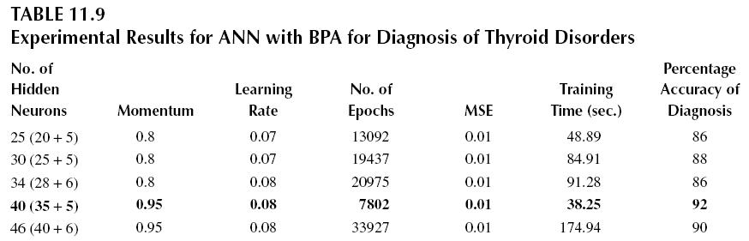
Results
ANN with BPA
The value of momentum, learning rate, and number of hidden neurons were changed to get different ANN models and choose the best one. The number of maximum allowable epochs was 35,000. Table 11.9 shows the experimental results of diagnosis using ANN with BPA.

Slide 40
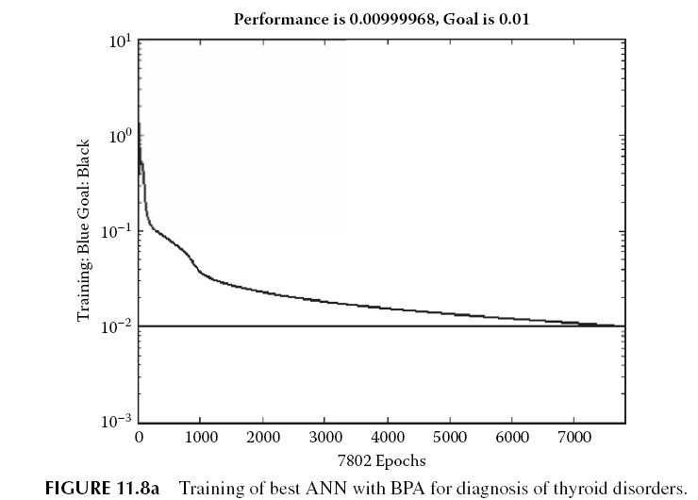
ANN with BPA

Slide 41
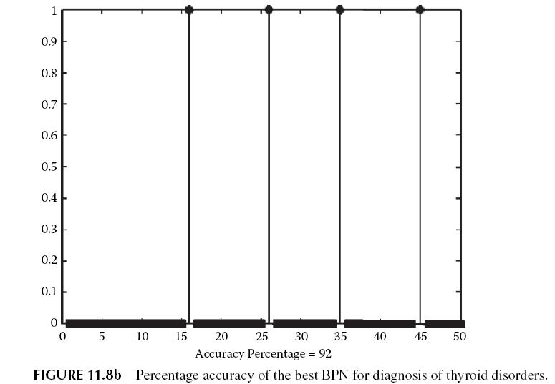
ANN with BPA
From the table, it is clear that the ANN with 40 hidden neurons and having a percentage accuracy of diagnosis of 92 percent is the best ANN for diagnosis of thyroid disorders.

Slide 42
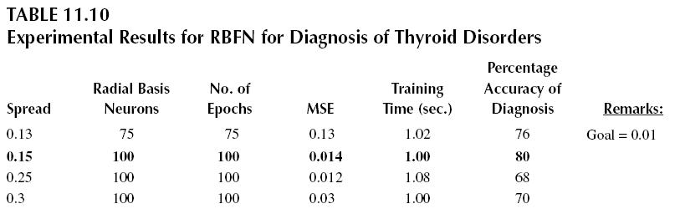
ANN with BPA
This shows that the diagnosis is correct in 46 out of 50 instances in this case of thyroid disorders.

Slide 43
RBFN
The experimental results of diagnosis using RBFN are shown in Table 11.10.
From this table, it is clear that the RBFN model with a spread value of 0.15, a number of hidden neurons equal to 150, and an accuracy of 80 percent is the best RBFN model or diagnosis of thyroid disorders.
Figure 11.9a shows the training curve for the best RBFN for the diagnosis of thyroid disorders, and Figure 11.9b shows the graphical representation of accuracy of the best RBFN for diagnosis of thyroid disorders.
This shows that the diagnosis is correct in 40 out of 50 instances in case of thyroid disorders.

Slide 44
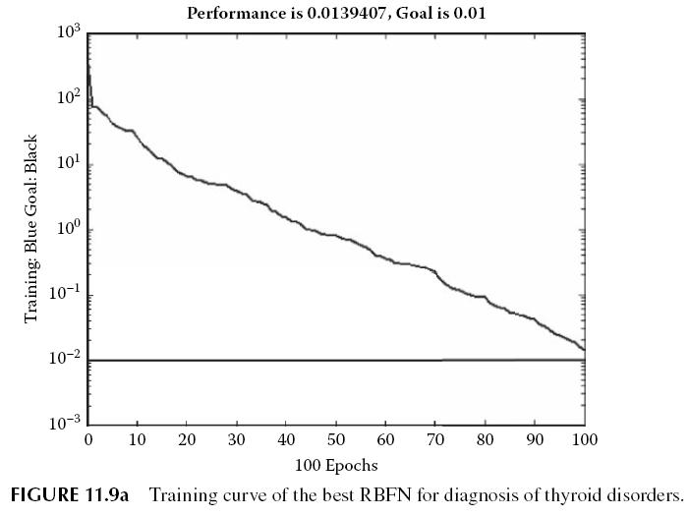
LVQ Network
The Kohonen’s learning rate was set to 0.09, and the performance function used was MSE. Table 11.11 shows the experimental results for LVQ networks.

Slide 45
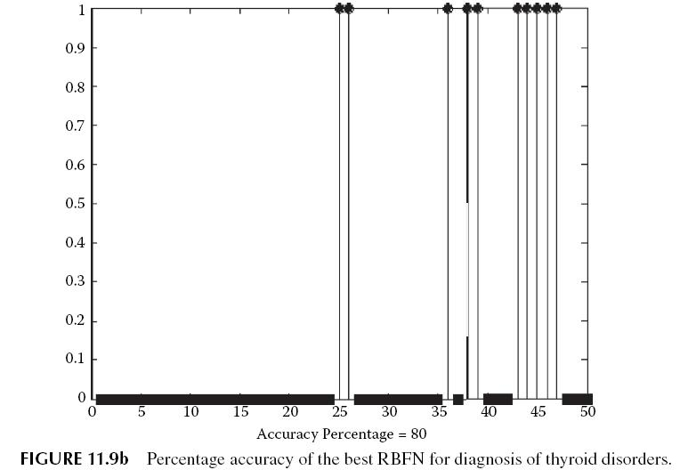
LVQ Network

Slide 46
LVQ Network
The network with 28 hiddenneurons and an accuracy of 95.38 percent is the best LVQ network.
Figure 11.10a shows the training curve for the best LVQ network for the diagnosis of thyroid disorders, and Figure 11.10b shows the graphical representation of accuracy of the best LVQ network for diagnosis of thyroid disorders.
This shows that the diagnosis is correct in 49 out of 50 instances in case of thyroid disorders.

Slide 47
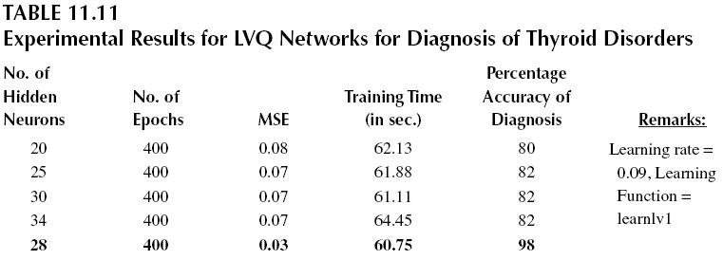
Performance Comparison
Table 11.12 shows the performance comparison of the three ANNs to find the best diagnostic system for diagnosis of thyroid disorders.
Hence, LVQ neural networks are best in diagnosis of the thyroid problem in this case.

Slide 48
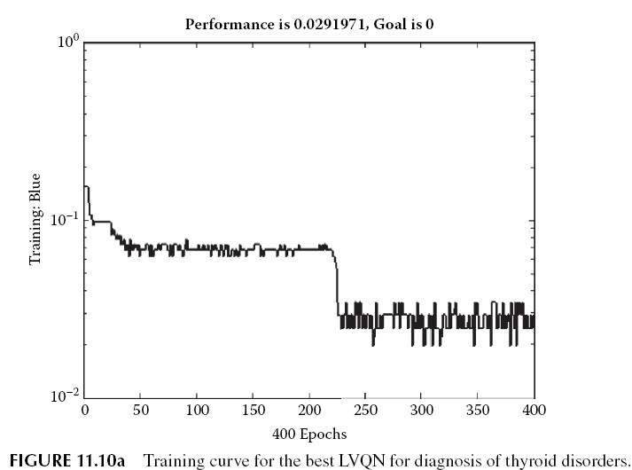
Performance Comparison

Slide 49
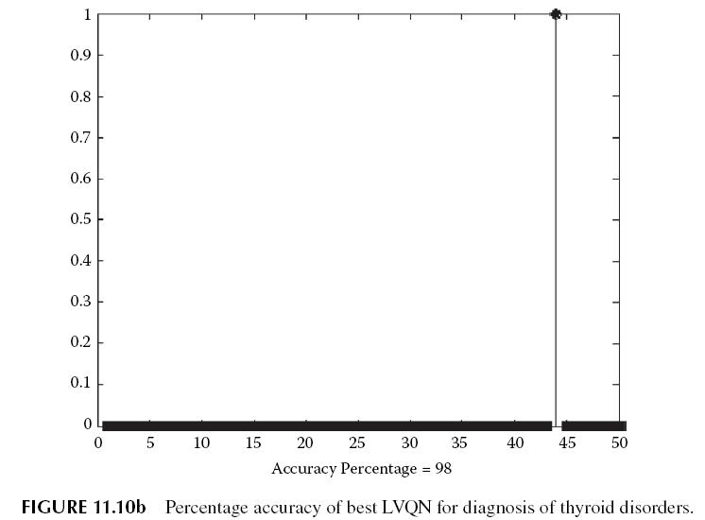
Performance Comparison

Slide 50
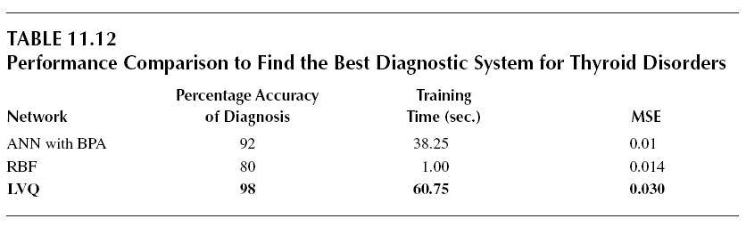
Performance Comparison

Slide 51
SKIN DISEASES
Next we study the skin diseases. Skin diseases, or dermatoses, include skin cancer, eczema, psoriasis, acne, impetigo, scabies, sunburn, warts, skin tags, Fifth Disease, tinea, herpes, ulcers, and pruritus (Jobling 2007; Lofholm 2000; Schwartz 2006).
In contrast to the situation in developed countries, malignant melanoma and non-melanoma skin cancers are rare in the indigenou populations of most developing countries, and among those with pigmented skins in genera
The exception is the very high risk of skin cancers in albinos (Kingman 2005). According to a survey of skin-related issues in Arab Americans, the most common self-reported skin conditions were acne, eczema/ dermatitis, warts, fungal skin infections, and melasma.l.

Slide 52
SKIN DISEASES
Significant associations exist between socioeconomic status and having seen a dermatologist. Attitudes surrounding skin perception were related to the number of years of residence in the United States.
Skin conditions and other related issues that affect Arab Americans are similar to those which affect other skin-of-color populations (EI-Essawi 2007).
According to a report on Occupational Skin Disorders by SHARP (Safety & Health Assessment & Research for Prevention), Washington, 13 percent of the population was suffering from skin disorders.
Industries with high dermatitis claims reporting include Agriculture and Production Crops, Health Services, and Construction Special Trade Contractors (SHARP 1998).

Slide 53
Data Set for Skin Diseases
The data set contains 34 attributes, 33 of which are linear valued and one of which is nominal.
In the data set, the number of instances is 366 and missing attribute values are 8 (in the Age attribute); the actual number of instances used is hence 358, and number of attributes is 34.
Attribute information is given in Table 11.13. In the model, the number of instances in the training data set is 278, and number of instances in the testing set is 80.

Slide 54
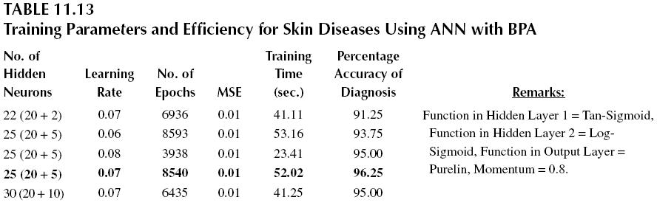
Results
ANN with BPA
The experimental results of diagnosis using ANN with BPA are shown in Table 11.13. From this table, it is clear that the ANN model with 25 hidden neurons and accuracy of 96.25 percent is the best ANN model for diagnosis of skin disorders.

Slide 55
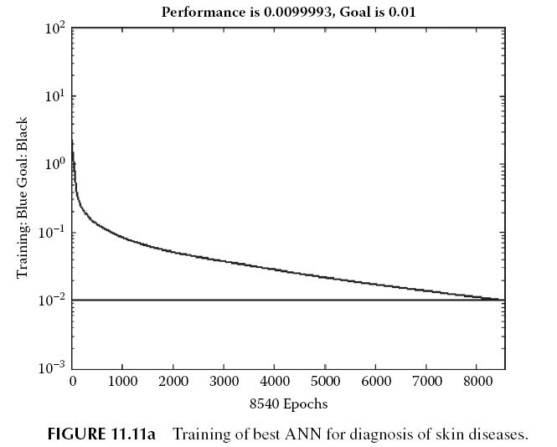
ANN with BPA

Slide 56
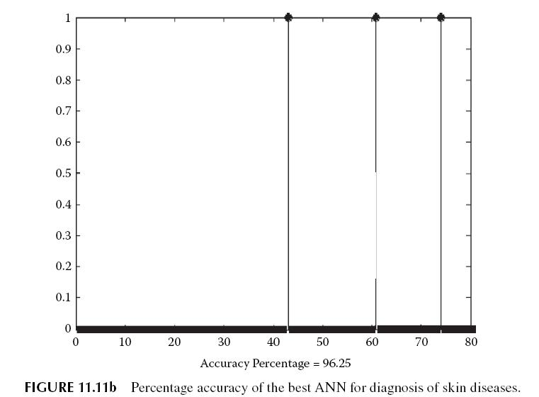
RBFN
In our experiment, the Radial Basis Function Network has an error goal of 0.01. The performance function MSE was used.

Slide 57
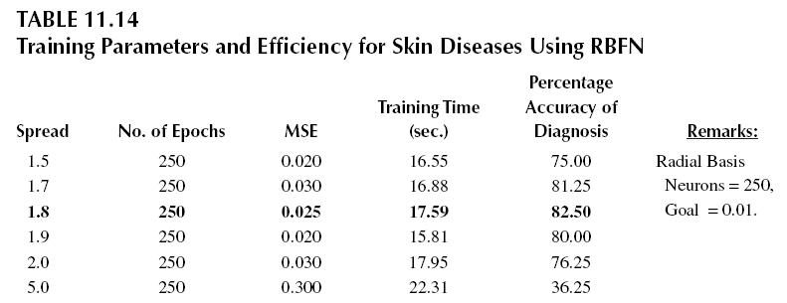
RBFN
Figure 11.12a shows the training curve for the best RBFN network, and Figure 11.12b shows the percentage accuracy of diagnosis using the best RBFN..

Slide 58
Diagnosis Using LVQ Network
Table 11.15 shows the experimental results for LVQ networks, which differ from each other on the basis of number of hidden neurons used.
The network with 25 hidden neurons and an accuracy of 97.5 percent is the best LVQ network.
Figure 11.13a shows the training curve for the best LVQ network.
Figure 11.13b shows the percentage accuracy of diagnosis using the best LVQ network.

Slide 59
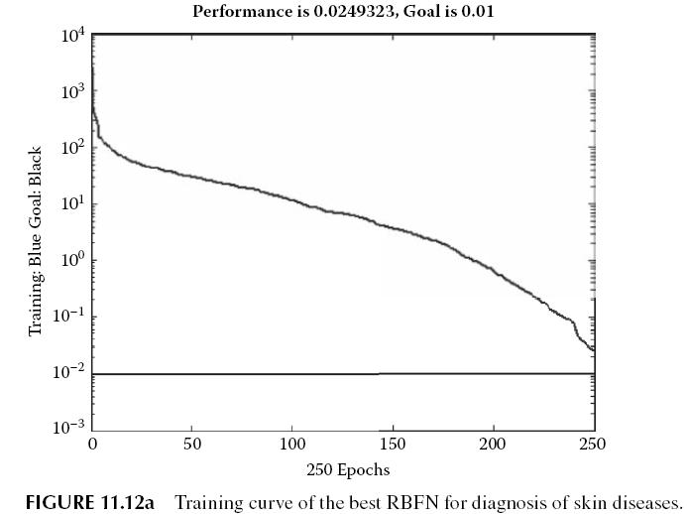
Performance Comparison
Table 11.16 shows the comparison of best results (for an optimized model) for three networks. On the basis of the experimenta observations of three neural networks, LVQN gives the highest accuracy, 97.5 percent, for diagnosis of skin diseases.

Slide 60
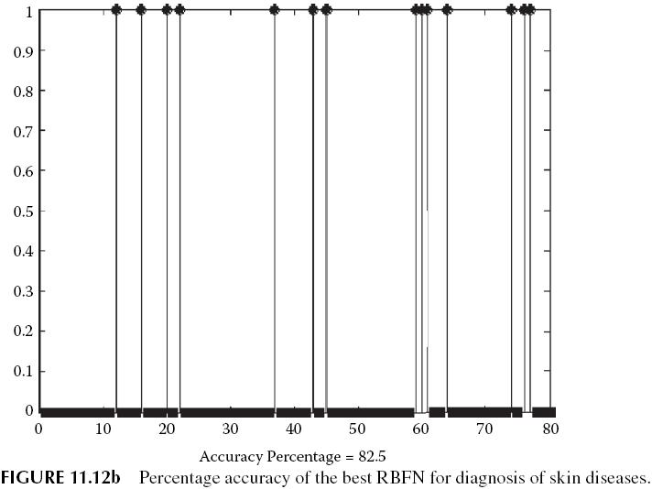
Performance Comparison

Slide 61
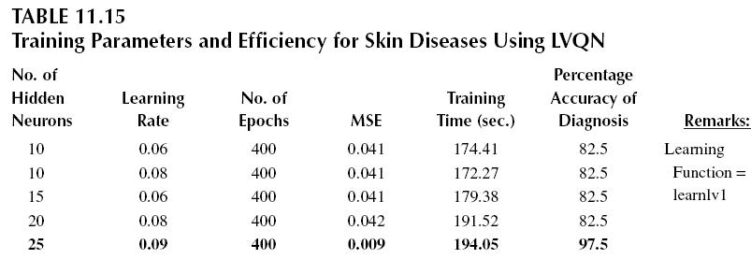
DIABETES
Continuing our discussion in the study of diseases, we now discuss diabetes. The World Health Organization (WHO) recognizes three main forms of diabetes mellitus: type 1, type 2, and gestational diabetes (occurring during pregnancy).
Foundation, showed that a large percentage of people with diabetes do not report being worried about the long-term diabetic microvascular complications associated with the condition, including diabetic retinopathy, which can lead to visual impairment an loss of vision.

Slide 62
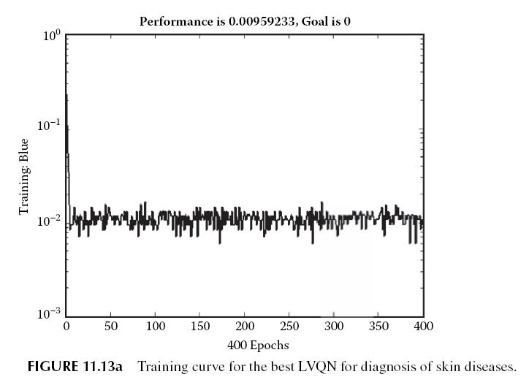
DIABETES

Slide 63
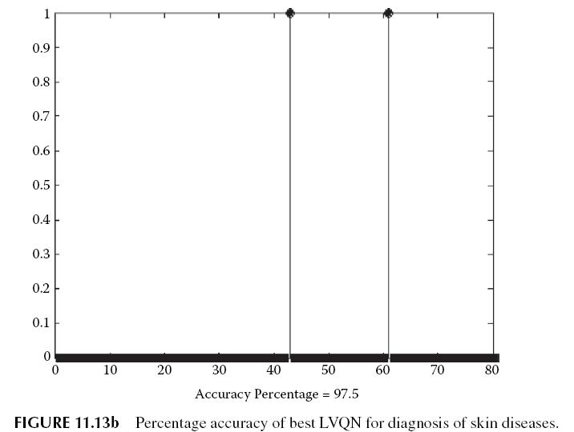
DIABETES

Slide 64
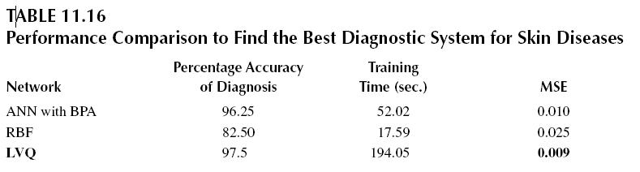
DIABETES
According to the survey by American Diabetes Association (ADA), 49 percent of the U.S. adults polled said they most feared cancer as a potential health problem, while just 3 percent said they worried about diabetes.
The survey results suggests that people need to assess their diabetes risk and take it more seriously (Dohney 2008).

Slide 65
Data Set for Diabetes
In the data set, the number of instances was 768, the number of attributes was 8, the number of instances in the training data set was 668, and number of instances in the testing set was 100. For each attribute, the information taken was (all numeric-valued) as follows:
Number of times pregnant
Plasma glucose concentration a 2 hours in an oral glucose tolerance test
Diastolic blood pressure (mm Hg)
Triceps skin fold thickness (mm)
Two-Hour serum insulin (mu U/ml)
Body mass index (weight in kg / (height in m)^2)
Diabetes pedigree function
Age (years)
Class variable (1 or 2)

Slide 66
Results
ANN with BPA
The architecture used in this experiment consists of three hidden layers and one purelin output unit.
Table 11.17 shows different models produced by changing the number of hidden neurons, momentum, learning rate, and transfer functions in hidden layers.
Figure 11.14a shows the training curve for the best ANN. Figure 11.14b shows the percentage accuracy of diagnosis using the best ANN.

Slide 67
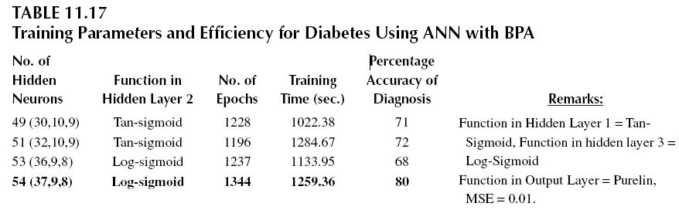
RBFN
From Table 11.18 it is clear that the RBFN network model with spread value 0.1 and accuracy of 68 percent is the best RBFN model for diagnosis of heart diseases.
Figure 11.15a shows the training curve for the best RBFN and Figure 11.15b shows the percentage accuracy of diagnosis using the best RBFN.

Slide 68
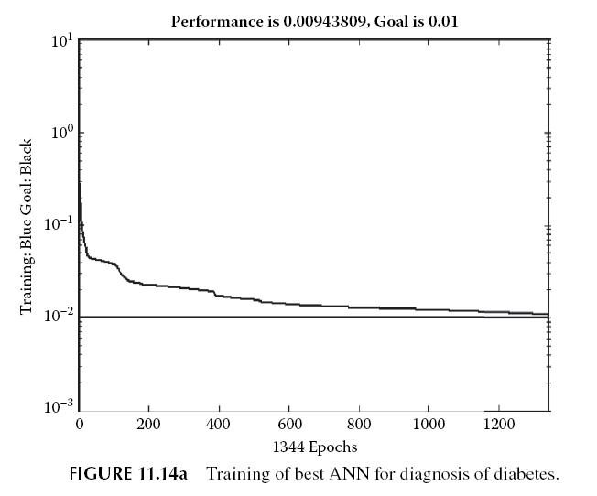
RBFN

Slide 69
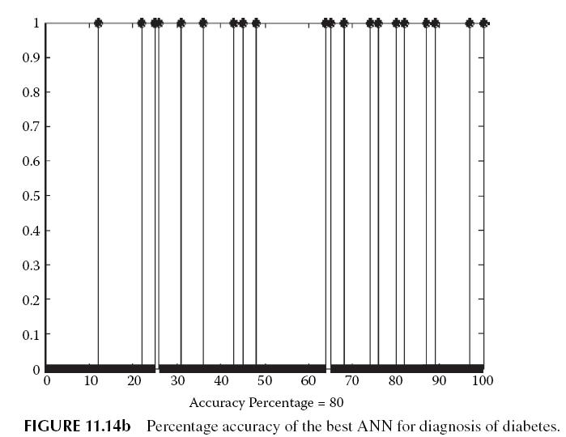
LVQ Network
The network with 30 hidden neurons and an accuracy of 80 percent is the best LVQ network. Figure 11.16a shows the curve for training of a neural network with LVQ and Figure 1.16b shows the percentage accuracy of optimized LVQ model on testing data set.

Slide 70
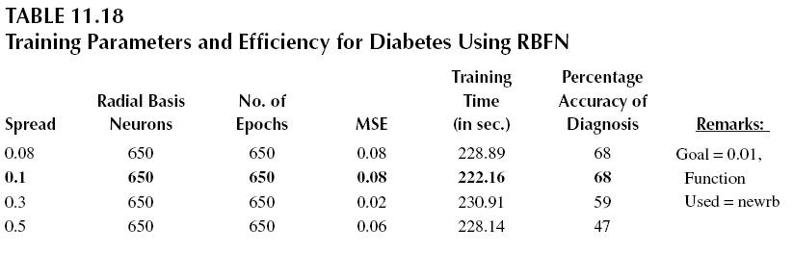
LVQ Network

Slide 71
Performance Comparison
Table 11.20 shows the comparison of best results (for optimized model) for three networks.
On the basis of the experimental observations of three neural networks, LVQN and BPA give the highest accuracy of 80 percent, but the training time for ANN with BPA is larger as compared to LVQN.
Hence LVQN is the best network for diagnosis of diabetes.

Slide 72
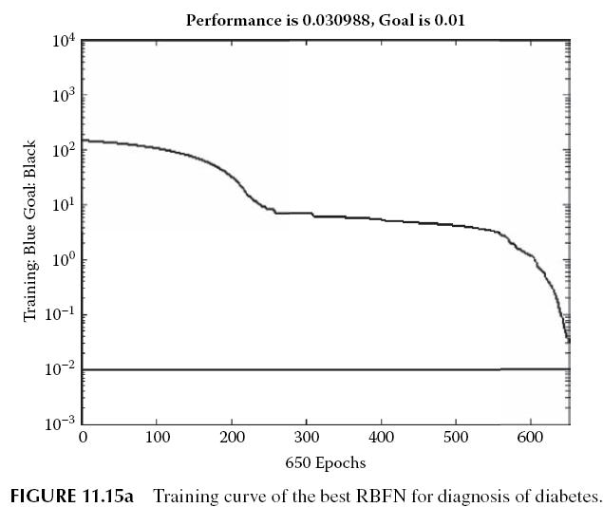
HEART DISEASE
Heart disease is the last category of disease that we study in this chapter. Various forms of heart disease include aortic regurgitation, cardiogenic shock, congenital heart disease, coronary artery disease (CAD), hypertrophic cardiomyopathy, ischemic cardiomyopathy, peripartum cardiomyopathy, tricuspid regurgitation, etc. (Drugs.com).

Slide 73
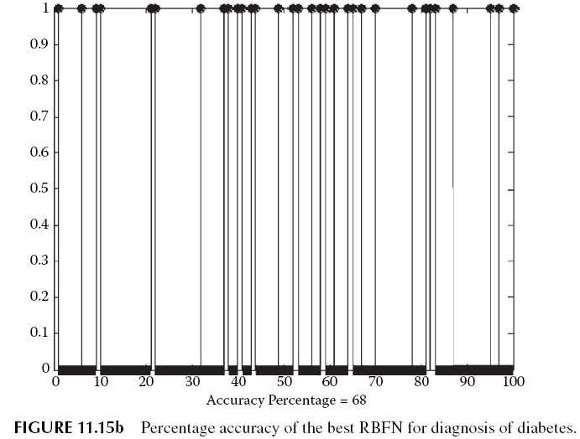
HEART DISEASE

Slide 74
HEART DISEASE
It kills some 350,000 people a year and leaves hundreds of thousands of people with debilitating heart disease (WHF 2007).
Most women mistakenly believe that breast cancer is the leading cause of death among females, underestimating heart disease as the nation’s biggest killer.
Heart disease claims the lives of 30 Australian women every day, almost 11,000 a year, yet only 30 percent of those questioned named it as the biggest killer, with most naming breast cancer, which kills about 2,600 annually (McClean 2008).
According to maps of world, the top ten countries with the highest death rates are Ukraine, Bulgaria, Russia, Latvia, Belarus, Romania, Hungary, Estonia, Georgia, an Croatia (Maps of world 2008).

Slide 75
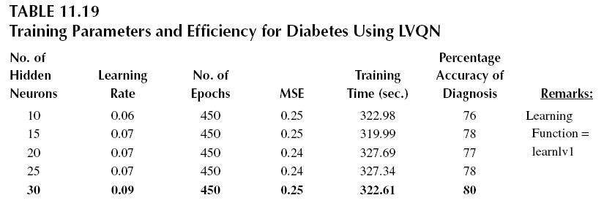
HEART DISEASE

Slide 76
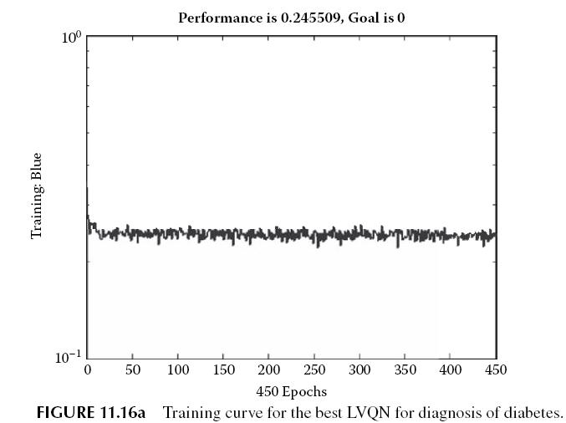
HEART DISEASE

Slide 77
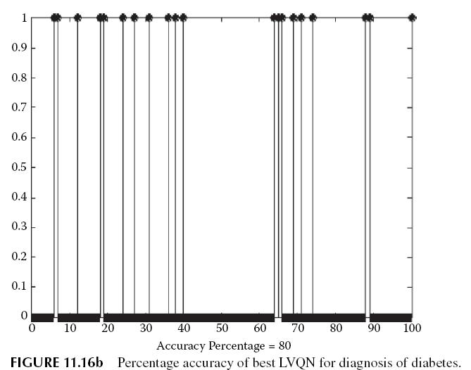
HEART DISEASE

Slide 78
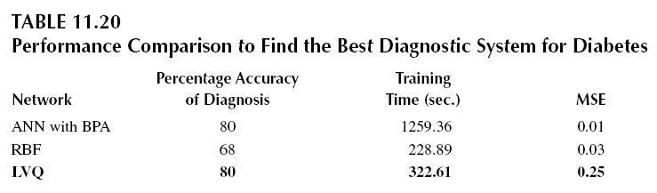
HEART DISEASE

Slide 79
Complete Attribute Documentation for Skin Diseases
Clinical Attributes Histopathological Attributes
Erythema, scaling, definite borders,
itching, koebner phenomenon,
polygonal papules, follicular papules,
oral mucosal involvement, knee and
elbow involvement, scalp
involvement, family history (0 or 1),
Age (linear).
Histopathological Attributes
melanin incontinence, eosinophils in the infiltrate, PNL infiltrate fibrosis of the
papillary dermis, exocytosis, acanthosis, hyperkeratosis, parakeratosis, clubbing
of the rete ridges, elongation of the rete ridges, thinning of th suprapapillary

Slide 80
Histopathological Attributes
epidermis, spongiform pustule, munro microabcess, focal hypergranulosis,
disappearance of the granular layer, vacuolisation and damage of basal layer,
spongiosis, saw-tooth appearance of retes, follicular horn plug, perifollicular
parakeratosis, inflammatory monoluclear infiltrate, band-like infiltrate

Slide 81
Data Set for Heart Diseases
From the data set the number of instances was 303, and the number of attributes was 13 with1 class attribute.
Attributes were sex, age, trestbps, chol, fbs, restecg, thalach, exang, oldpeak, slope, ca, thal, and class (the predicted attribute).
The number of instances in the training data set was 243, and the number of instances in the testing set was 60. These are given in Table 11.21.

Slide 82
Results
ANN with BPA
The values of learning rate and momentum factor were varied to get the best results.
The training function used was traingdm. Table 11.22 shows different models produced by changing the number of hidden neurons, momentum, learning rate and transfer functions in hidden layers.
From this table, it is clear that the BP network model with 48 hidden neurons and accuracy of 83.33 percent is the best ANN model for diagnosis of heart diseases.
Figure 11.17a shows the training curve for the best ANN. Figure 11.17b shows the percentage accuracy of diagnosis using the best ANN.

Slide 83

RBFN
Training parameters of different models based on RBFN are shown in Table 11.23. From this table, it is clear that the RBFN model with spread value 1.05 and accuracy of 78.33 percent is the best RBFN model for diagnosis of heart diseases.

Slide 84

RBFN

Slide 85

LVQ Network
The network was created and the number of hidden neurons was changed to get the best results. The parameters for these LVQ models are shown in Table 11.24.

Slide 86

LVQ Network
Figure 11.19a shows the curve for training of a neural network with LVQ, and Figure 11.19b shows the percentage accuracy of optimized LVQ model on testing data set.

Slide 87
Performance Comparison
Table 11.25 shows the comparison of best results (for optimized model) for three networks.
On the basis of the experimental observations of three neural networks, LVQN gives the highest accuracy of 86.70 percent for diagnosis of heart diseases.

Slide 88

CUMULATIVE RESULTS
On the basis of the experimental observations, the best accuracy of diagnosis in each of the six specified diseases is as summarized in Table 11.26.
In five out of six diseases, LVQ has produced the best accuracy of diagnosis, when trained on the specified data. Thus, LVQ can be effectively used in medical diagnosis.

Slide 89

CUMULATIVE RESULTS

Slide 90
CONCLUSIONS
Now we have some useful data to continue our discussion related to machine learning that we started in the previous sections.
Hence if a point in the input space is affected by some disease, it is highly likely that the points around also suffer from the same disease.
Although this must be generally true, yet breast cancer results show exactly the opposite. Here the most generalizing solutions are seen to return the best solution to the problem of breast cancer detection.
Say the ANN with BPA was trained in the most optimal manner and the LVQ training was nonoptimal. These may be the reasons for poor performance most of the time.

Slide 91

CONCLUSIONS

Slide 92

CONCLUSIONS

Slide 93

CONCLUSIONS

Slide 94


CONCLUSIONS

Slide 95
CONCLUSIONS
However, we justify the results considering all experiments as optimal. The notion that a localized ANN performs better or outperforms a generalized ANN is usually true but cannot be generalized to all the possible input cases.
The best way to understand this is by plotting the input space and seeing the distribution of the various classes there.
For now, we can just visualize the problems and the possible solutions and infer why some system performs better in a given set of circumstances.
For the rest of the cases, it is natural that the LVQ performs better due to its localized nature. We only discuss these results here. The particular efficiencies, time requirements, and architecture of the systems may be easily verified and commented.

